Slide 1
Vision and Mission of Ganpat University
Vision | It shall be the constant endeavour of Ganpat University to meet the educational needs of the youth in the areas of professional studies and provide state-of the art learning opportunities along with inculcation of values of commitment and uprightness.
Mission | Seek, search and offer programs that lead to symbiotic emergence of 'academic excellence' and 'industrial relevance' in education and research.

Slide 2
Vision and Mission of Computer Engineering / Information Technology Department
Vision | Department aims to achieve its recognition as a leading contributor in the area of technical education of computer engineering by practicing latest principles, tools and technologies to cope with current and future challenges and hence contributing to global welfare.
Mission | To educate and inculcate strong fundamentals of science and computer engineering through best teaching learning practices. To impart high quality education to acquire skills to conduct research and solve complex problems through modern tools, technologies and innovative practices. Enabling youth for employability, social upliftment, following good moral practices and professional ethics. Preparing youth for contributing in advancements of technology and society. Encouraging students to be adaptive, courageous and life-long learners.

Slide 3
Capstone Project - II Course Outcomes
After successful completion of this course, student will be able to
1. Select, collect and use the required information/knowledge to solve the problem.
2. Logically choose relevant possible solution(s).
3. Assess the impact of project on society.
4. Communicate effectively and confidently as a member and leader of team.
5. Prepare the project report

Slide 4


Attendance
Management
System
Team Number :- 2
Guided By : Prof. Nishi Patwa Ma’am

Slide 5
ABSTRACT
This web-based Attendance Management System (AMS) simplifies student attendance tracking for a specific department in an educational institution. Built with Python, Qt5, and SQLite, it offers secure login and eight user interfaces for different roles. To ensure data integrity, faculty deletion automatically reassigns students to another course faculty. The admin and department head manages users, faculty, students, and courses. Faculty record attendance, while students view their overall and date-wise attendance. Secure data resides in a SQLite database. Customizable settings ensure seamless department-wide attendance management .

Slide 6
Content
Introduction
Literature Survey
Requirements
Project Phases
Diagram
Prototypes
Conclusion
Future Development
References

Slide 7
Introduction
The traditional method of manually recording student attendance in educational institutions is often tedious, error-prone, and time-consuming. This project presents an innovative solution: a web-based Attendance Management System (AMS) designed specifically for a department within an institution. Developed using Python, a versatile programming language, Qt5 for a user-friendly graphical interface, and SQLite for efficient data storage, this AMS streamlines the attendance tracking process for both faculty and students.
The application is structured with a secure login system that grants access to eight distinct user interfaces, each tailored to the specific needs of different user roles within the department. This ensures a user-friendly and role-based experience for everyone involved.
Benefits:
Simplifies attendance tracking and management
Saves time and reduces errors
Provides easy access to attendance data
Offers flexibility for different user needs

Slide 8
Features:
Secure login system
Role-based user interfaces (8) for:
1. Department Head (admin)
2. Faculty
3.Students
Smooth faculty deletion with automatic student reassignment
Attendance recording by faculty
Attendance viewing by students (overall & date-wise)
Secure data storage in SQLite database
Customizable default settings

Slide 9
Existing Problems
Existing problems in the Attendance Management System include:
1. Lack of robust authentication mechanisms beyond basic username/password.
2. Potential data integrity issues if a faculty member is deleted, necessitating manual reassignment of students.
3. Limited customization options for course and faculty management.
4. Absence of encryption or other security measures for sensitive data.
5. Possible scalability concerns with larger departments or increased data volumes.
6. Dependency on local storage (SQLite), potentially limiting accessibility and scalability.
7. Limited error handling and recovery mechanisms.
8. Absence of features for automated reporting or analytics.

Slide 10
2. Literature
Survey
2.1 Efficiency Improvement
2.2 Accuracy Enhancement
2.3 Enhanced Data Accessibility
2.4 Student Engagement
2.5 Administrative Benefits
2.6 Integration with Learning Management Systems
2.7 Data Security Concerns
2.8 User Acceptance
2.9 Mobile Accessibility
2.10 Future Trends

Slide 11
3. Requirements
3.1 Functional Requirements
3.2 Non Functional Requirements
3.3 Hardware Requirements
3.4 Software Requirements
3.5 Align Model
3.6 Feasibility Study

Slide 12
Admin
1
Students
2
Faculties
3
3.1 Functional Requirements

Slide 13
Performance
Security
Scalability
Recovery & Backup
Accessibility
3.2 Non - Functional Requirements

Slide 14
Processor
Intel Core i3 or equivalent
2. Connection
Ethernet connection (LAN) OR a wireless adapter (Wi-Fi)
3.Hard Drive
Minimum 32 GB; Recommended 64 GB or more
4. Memory
Memory (RAM) 4GB or higher
3.3 Hardware Requirements

Slide 15
01
Front End
Python
02
Back End
SQLite
03
Framework
QT5
04
Operating System
Windows
Linux
Mac
05
Web Browsers
Chrome
Safari and more
3.4 Software Requirements

Slide 16
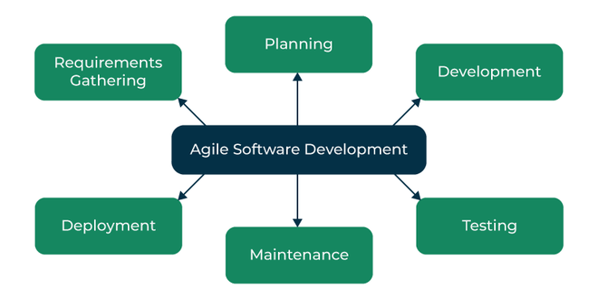
Agile Model

Slide 17
Technical Feasibility
Economical Feasibility
Operational Feasibility
Scheduling Feasibility
1
2
3
4
3.6 Feasibility Study

Slide 18
4. Project Phases
Phase 5
System Testing and Maintenance
Phase 1
Requirements Gathering and Analysis
Vestibulum nec congue tempus
LOREM 4
Deployment and Training
Phase 2
Design and Development
Phase 3
Prototype Testing and Refinement

Slide 19
5. Diagrams
ER Diagram
Use Case Diagram
Class Diagram
Sequence Diagram
Activity Diagram
Login Activity Diagram
Statechart Diagram
Data Flow Diagram
DFD level 0
DFD level 1
DFD level 2

Slide 20
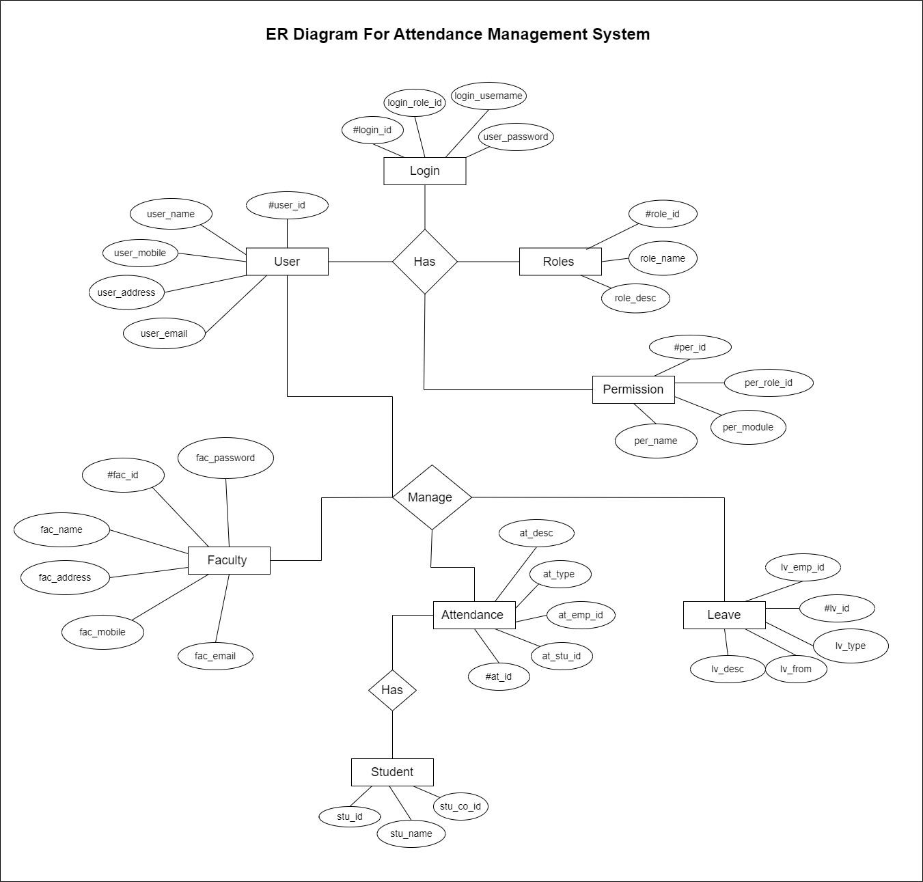
1. Entity Relationship Diagram

Slide 21
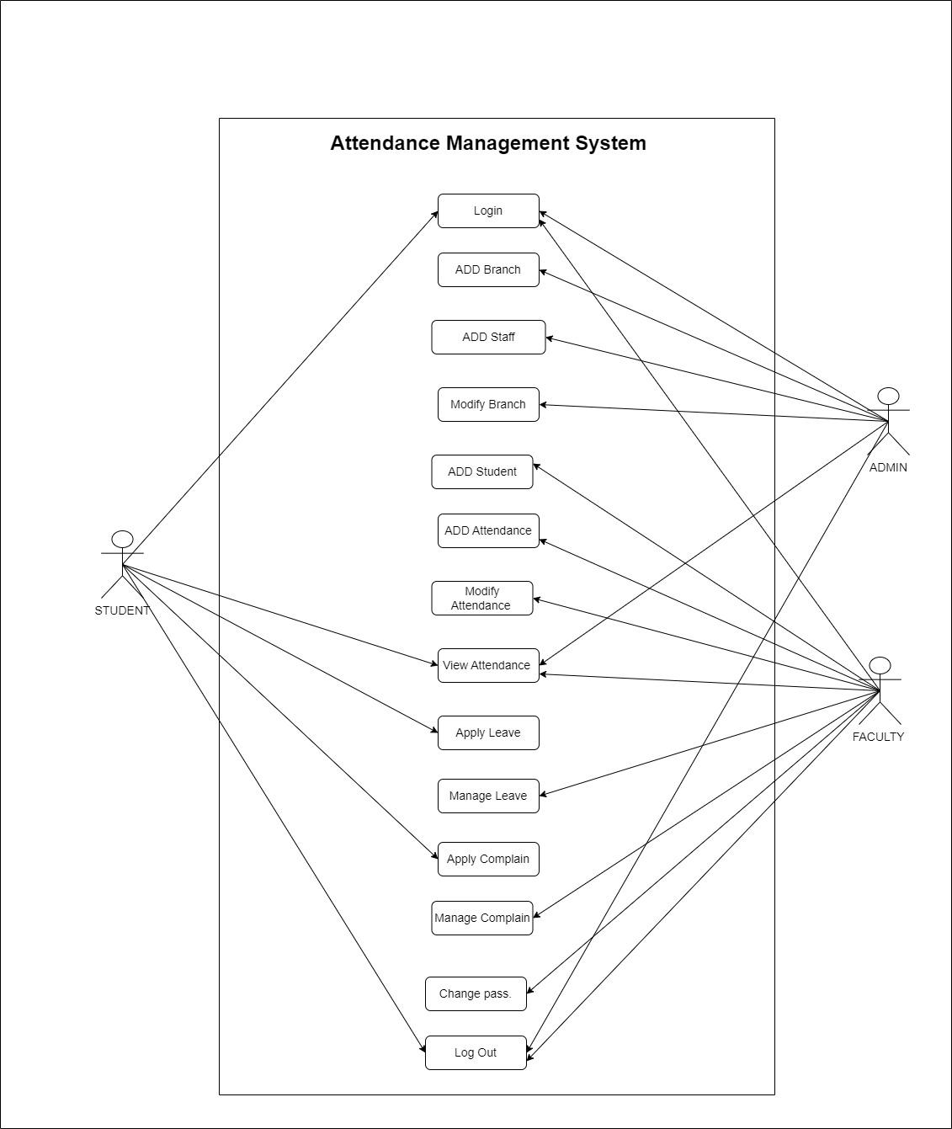
2. Use Case Diagram

Slide 22
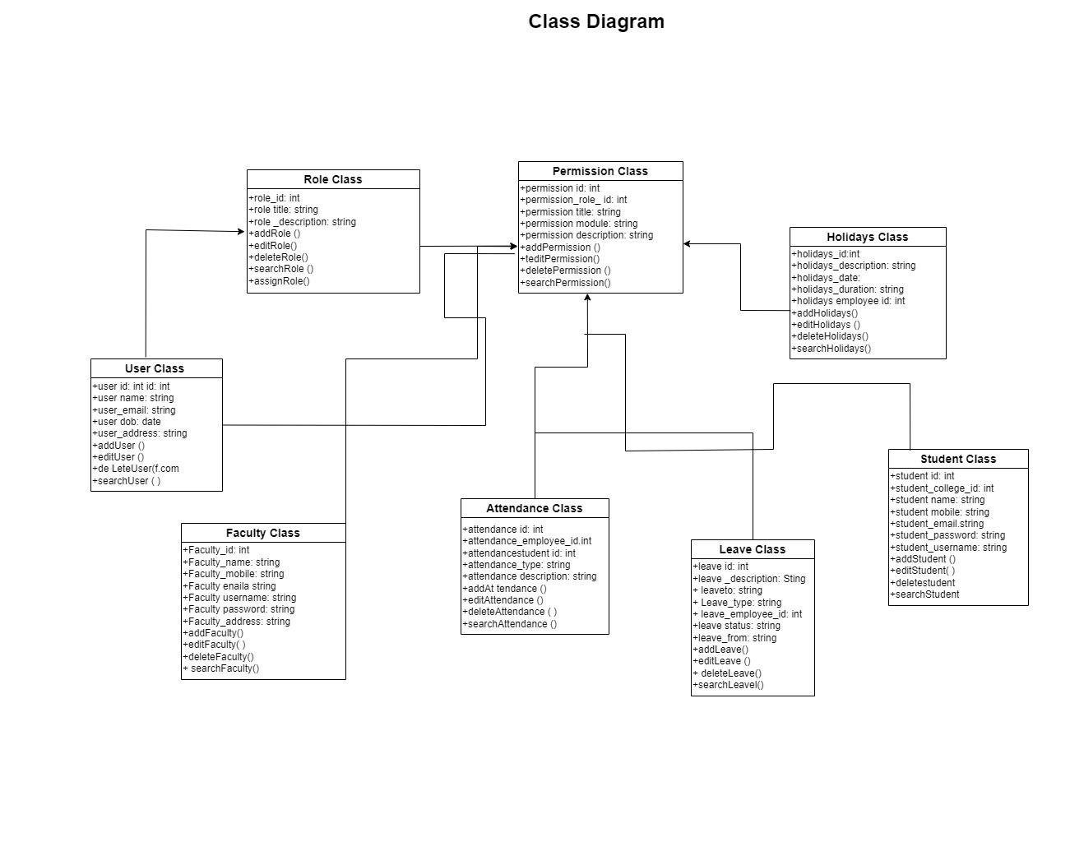
3. Class Diagram

Slide 23
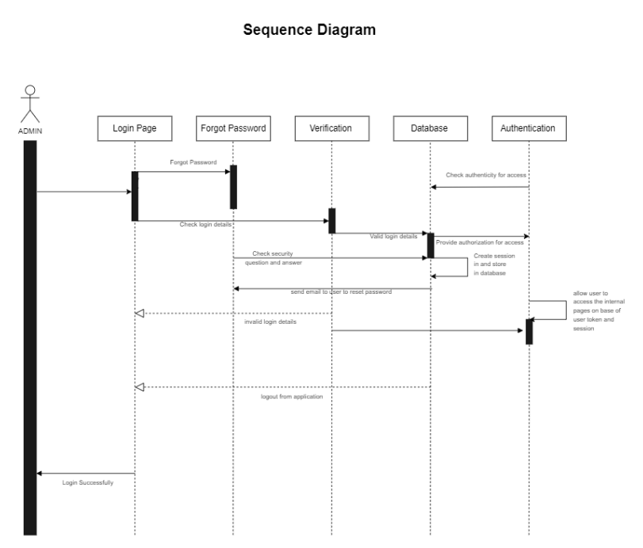
4. Sequence Diagram

Slide 24
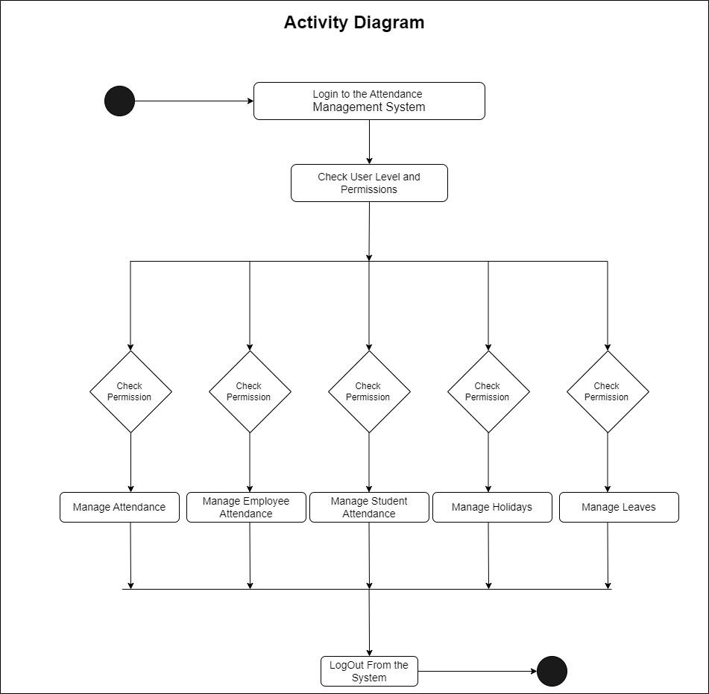
5. Activity Diagram

Slide 25
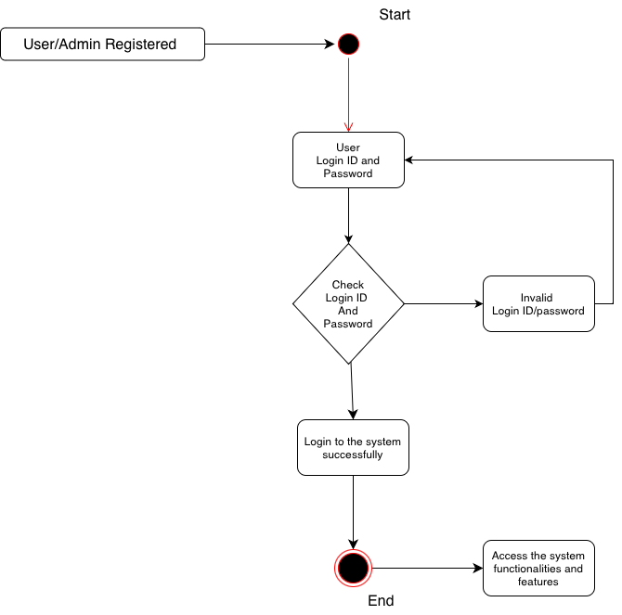
Activity Login Diagram

Slide 26
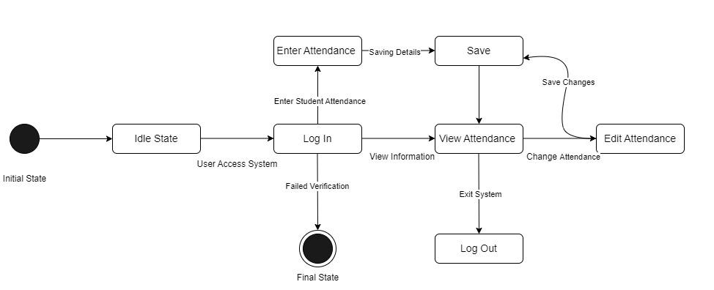
6. Statechart Diagram

Slide 27
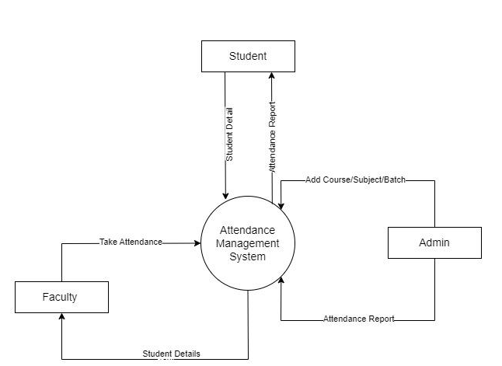
3. Data Flow Diagram
DFD Level 0

Slide 28
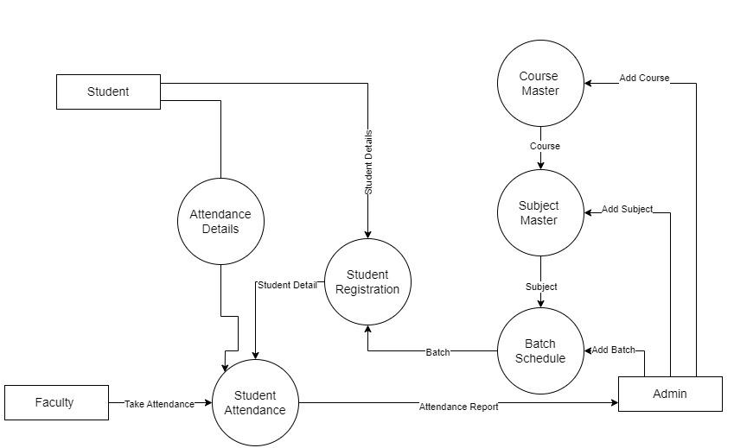
DFD Level 1

Slide 29
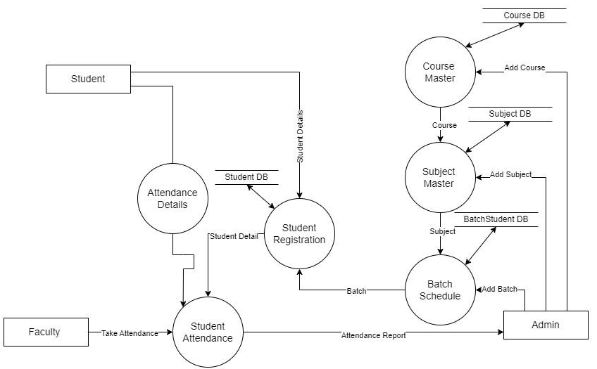
DFD - level 2

Slide 30
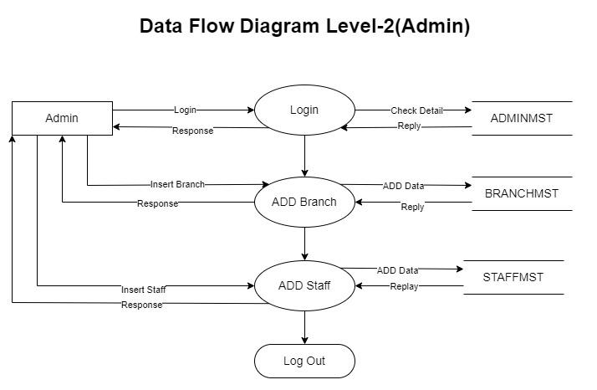

Slide 31
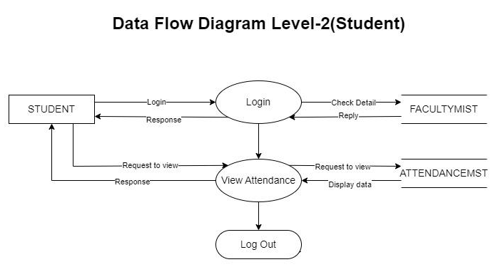

Slide 32
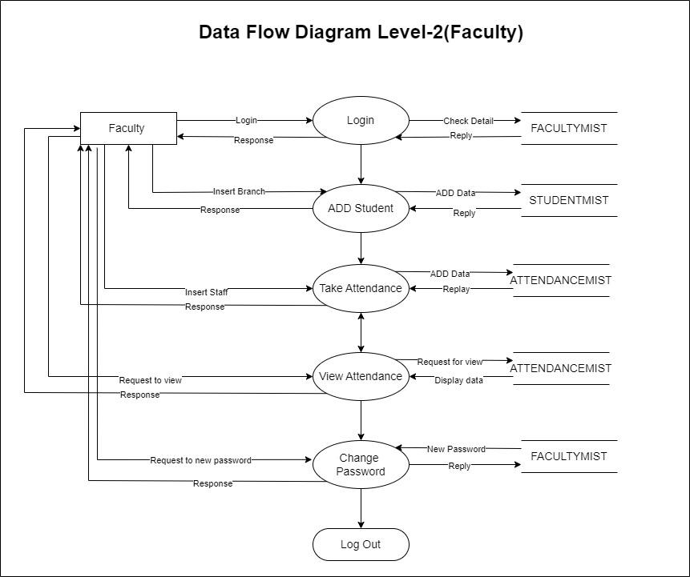

Slide 33
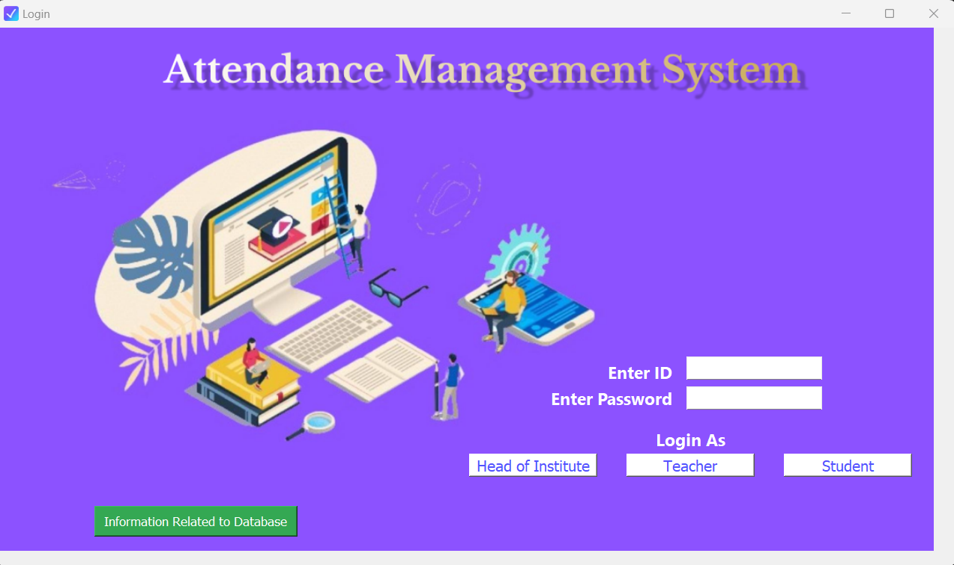
6. Prototypes
Login Page

Slide 34
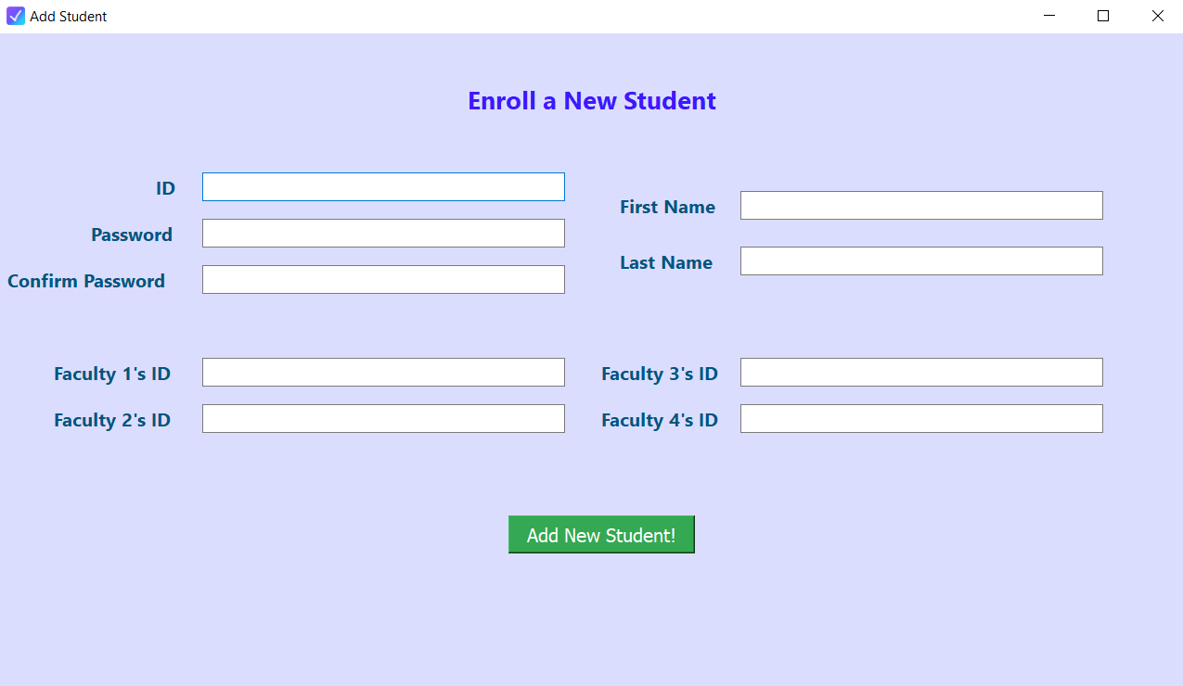
Add Student Page

Slide 35
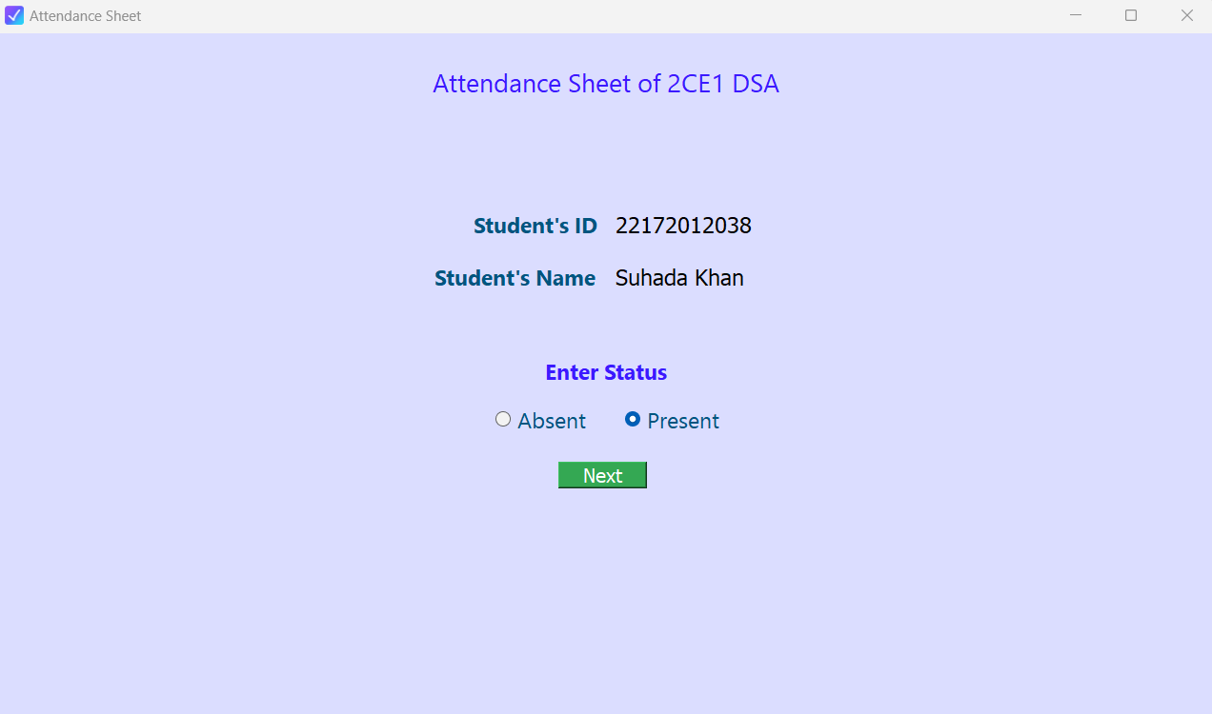
Attendance Sheet Page

Slide 36
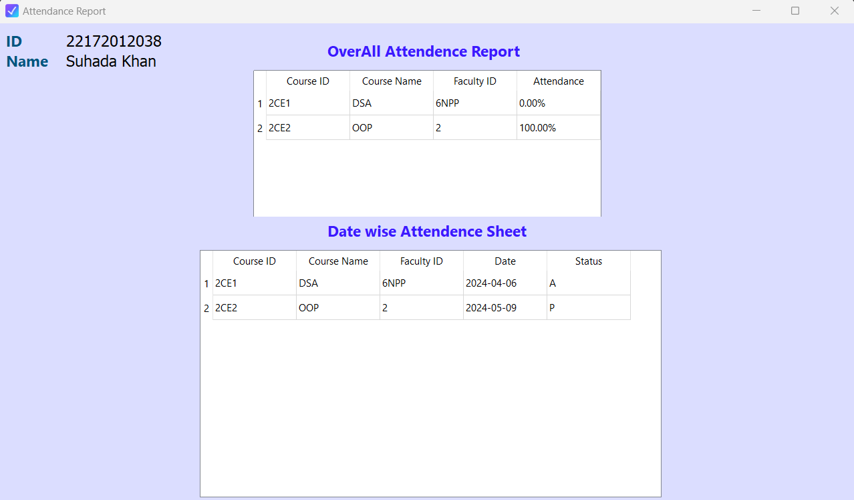
Attendance Report Page

Slide 37
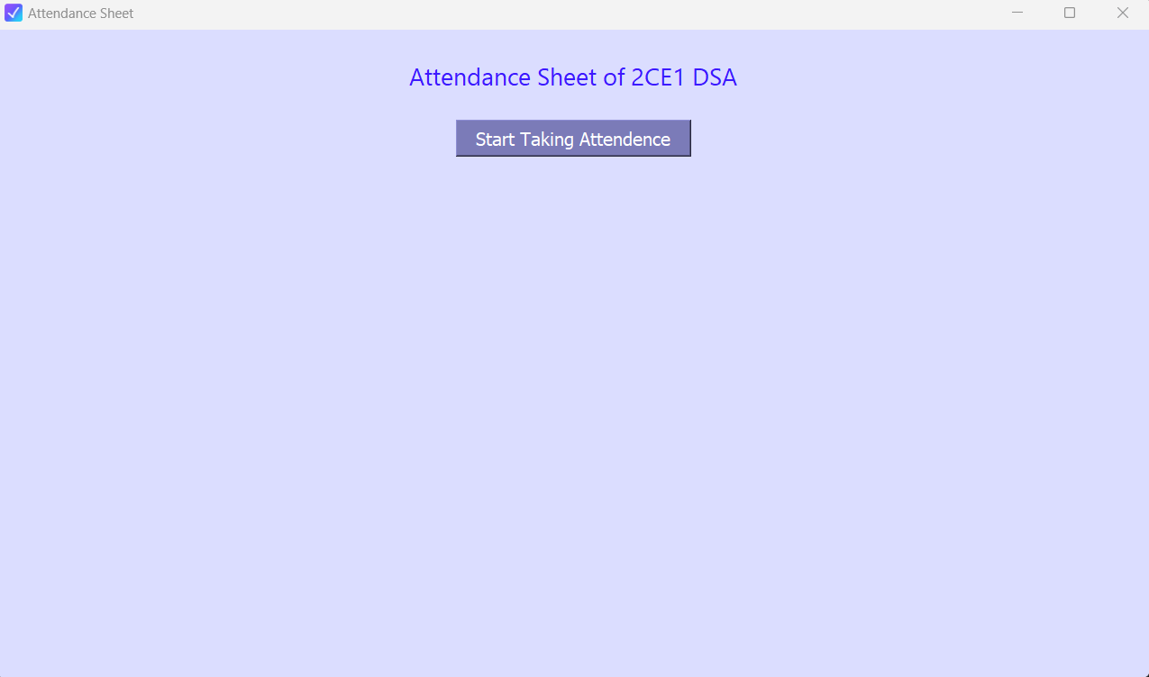
Start Taking Attendance

Slide 38
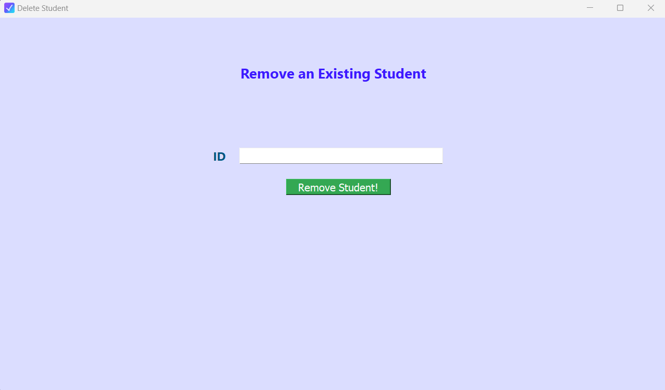
Remove Student

Slide 39
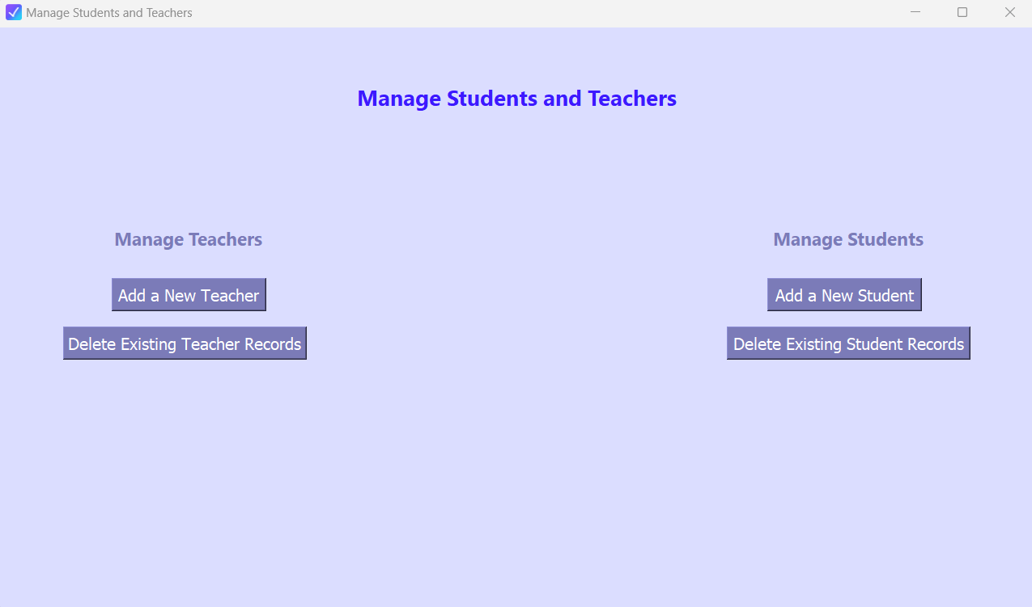
Manage Students and Teachers

Slide 40
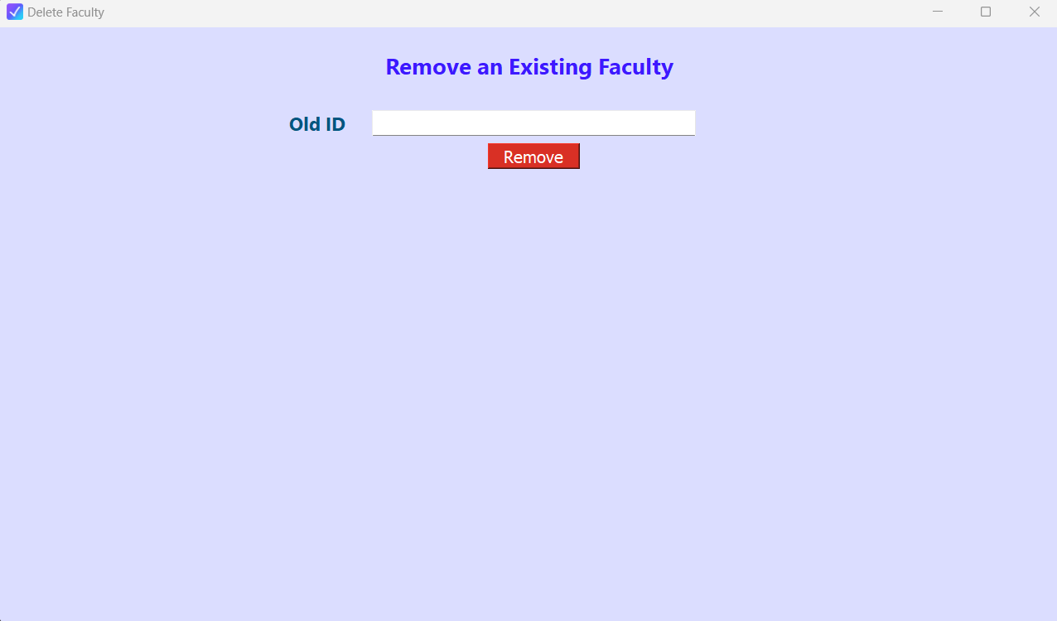
Remove an Existing Faculty

Slide 41
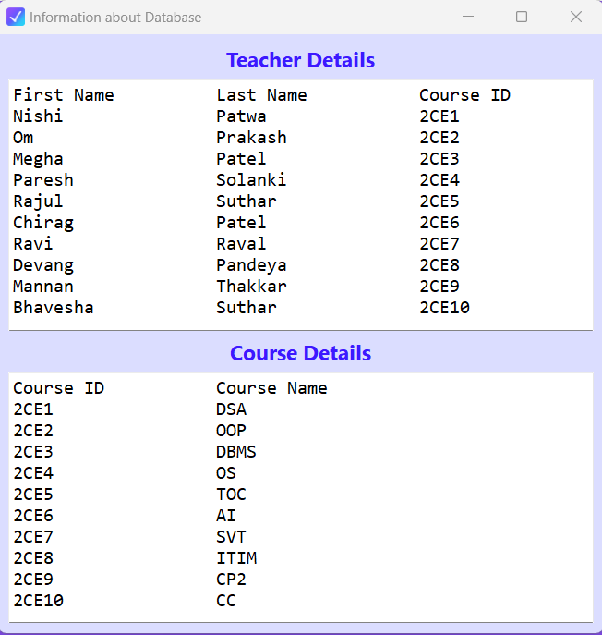
Information About Database Page

Slide 42


Slide 43
Conclusion
The AMS offers a user-friendly and centralized solution for attendance management within a department. It streamlines processes for administration, faculty, and students. While the provided information did not disclose the full extent of functionalities, the outlined features demonstrate the potential benefits of the AMS:
Improved data accuracy and accessibility
Reduced administrative workload
Enhanced transparency and communication regarding attendance
Further development could explore functionalities like:
Integration with existing student information systems
Advanced reporting and analytics
Mobile application access for added convenience
By addressing these aspects and conducting thorough testing, the AMS can be a valuable tool for educational institutions to manage student attendance effectively.

Slide 44
Summary
The AMS is a web-based system developed using Python, QT5, and SQLite for managing student attendance within a specific department.
Users are categorized as Department Head, Faculty, and Students, each with dedicated interfaces.
The Department Head can manage courses, faculty, and students, including assignment, deletion, and enrollment functionalities. An automated reassignment feature ensures students are not left without a faculty member if a faculty is deleted.
Faculty can take attendance for students enrolled in their assigned courses.
Students can view their overall and date-wise attendance for their chosen courses.
The system utilizes SQLite for database storage, promoting ease of use and scalability.

Slide 45

8. Future Development
There are many additional features and functions,which can be plan to be incorporated during the future enhancement of this project are :
Mobile support application
Improved User Interface
Enabling to switch theme to dark mode
Adding more modules as per needed
Automated Notifications
Integration with Student Information Systems
Multi-Department Support
Enhanced Security Features
Mobile App Development
Face Recognition

Slide 46
References
Chatgpt
Wikipedia
Projectzone
1000 Project
Freeprojectz
HubSpot
JavatPoint
Tech Target
Tools
Draw.io
Figma
Canva

Slide 47
About Tools & Technology
Python: A general-purpose, high-level programming language known for its readability and extensive libraries.
Qt5: A powerful framework for developing cross-platform applications with rich graphical user interfaces.
SQLite: A self-contained, lightweight database engine well-suited for storing and managing structured data like the AMS's attendance records.

Slide 48
About College (UVPCE)
Ganpat University-U. V. Patel College of Engineering (GUNI-UVPCE), established in 1997, aims to mold students into technically adept individuals. With a sprawling 25-acre campus, it offers diverse undergraduate, postgraduate,and Ph.D. programs. The institute prioritizes industry- relevant education, fostering ties with prominent companies for placements and research collaboration. Boasting superior infrastructure, including CoEs like Bosch-Rexroth and Energy Innovation Centre, it emphasizes practical learning. Named after industrialist Shri Ugarchandbhai Varanasi Bhai Patel, GUNI-UVPCE is approved by AICTE and offers a conducive environment for learning,research, and training, contributing to the holistic development of aspiring engineers.

Slide 49

Thank You

